Slide 1
Human rights principles and taxation
Country experiences: Uruguay
Nicole Bidegain
Development Alternatives with Women for a New Era (DAWN)

Slide 2
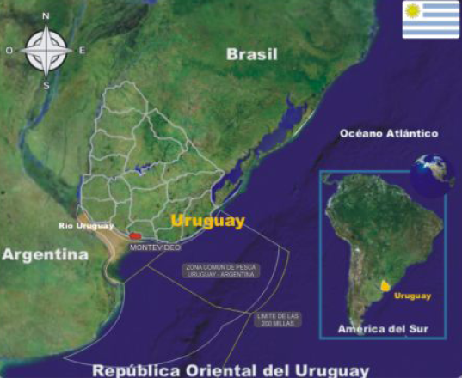
Uruguay
Population: 3.3 million people, 93% urban
Surface: 176 215 km2
GDP: 50 billion USD (2012)
GDP per capita: 14.800 USD (2012)
Average inflation: 7,5% (2012)
Average Unemploymment: 6,5% (M 4,9% - W8,3% ) (2012)
Minimum wage: 355 USD per month (2013)
Poverty: From 2006 to 2012 the levels of people living in poverty has been reduced from 34,4 to 12.4 %; the proportion of people living in extreme poverty was reduced from 2,7 to 0,5% (2013).
Progressive goverment ruling the country since 2005. Slogan: “Growth with Equality”
Notes:
NET PUBLIC DEBT/GDP: 30%
Real wage: 4,2 (2012

Slide 3
Source: Ferreri 2013

Slide 4
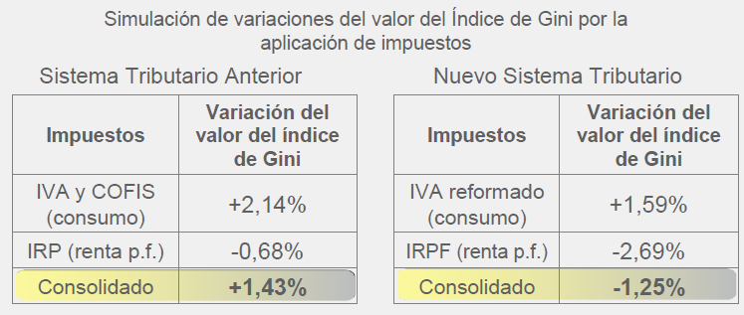
Redistribution impacts of the new tax system
Population | Income | Previous Tax System | Current Tax System
 | 50% | Paid 60% of the taxes | 50% of the taxes
 | 50% | Paid 40% of the taxes | 50%of the tax revenue
80%
20% richest
Source: Asesoria Economica DGI, 2013
Notes:
Ferreri reminded that under the previous tax system, 80% of the poorest population held 50% of the income and paid 60% of the taxes. Under the new system, it is paying 50% of the taxes. Likewise, the richest 20% was paying 40% of the taxes and is now paying 50% which is more consistent with income percentages.

Slide 5
1 possitive example : Progressive personal income taxation
Posstive impact on poor, woman and LGBT
  While income derived from capital sources is taxed at a proportional rates (from 3% to 12%), income derived from wages and pensions are taxed at progressive rates.
Increase of the minimun taxable income derived from wages (7 BPC - USD 812 per month) and pensions (8 BPC – USD 928 per month)
An additional maximum tax rate of 30% for income derived from wages (115 BPC – USD 13.340 per month).
Joint assessment for married couples is permitted (including same sex couples). A different scale rate applies to individuals opting for this regime.
Deductions are allowed
  Per child under 18 and per person with disability.
  Per payments on annual rent on permanent housing.
Since 2012
Notes:
Capital income, such as interest, dividends, and other capital income, is taxed at rates between 3 and 12 percent, depending upon the nature of the income and residency status.
Direct taxes also include a tax/contribution that finances the National Health Insurance system. It depends on the beneficiary’s level of labor earnings and on whether the worker is the sole beneficiary, or if members of his or her family are also covered. Finally, there is a small tax on private labor earnings that support a Labor Retraining Fund (Bucheli 2013, 6).
En 2013 aumentó la BPC: 2.598 (USD 116) para corregir la inflación.
Wages (7 BPC - USD 812 per month) and pensions (8 BPC – USD 928 per month).
El MNI se duplica entonces conviene tributar si la suma de los dos ingresos es menor a 40.000 porque se exonera el pago. También conviene en el caso que uno de los integrantes no trabaje. Las retenciones y anticipos mensuales del IRPF de uno de los integrantes del núcleo familiar disminuyen en un 5% siempre que alguno de ellos no haya sido contribuyente del IRPF en el año anterior. ¿Cuándo no conviene tributar como núcleo familiar? No conviene cuando, por ejemplo, cada uno de los integrantes cobra una remuneración mayor a $ 18.000 y no tienen hijos menores. Tampoco conviene si la remuneración de cada uno de los integrantes es mayor a $22.000 y tienen dos hijos menores. http://www.guyer.com.uy/es/what_we_do/news-knowledge/guyer-responde/contenido-guyer-en-responde/nucleo-familiar-como-sujeto-pasivo-del-irpf/
Per child under 18 (percentage of $30.000)
Housing deduction: Crédito hiipotecario o alquiler: 6% hasta $9.000.

Slide 6
2 Possitive Example: Preventing regressive effect of Indirect Taxes
Posstive impact on poor, woman and LGBT
VAT’s standard was reduced from 23 to 22%.
VAT’s minimum rate was reduced from 14 to 10%: For several types of food, such as meat and bread, health care items and passengers land transport.
VAT’s exemption: Goods and services considered basic necessities (for example, education and milk).
VAT exemption of goods and services acquired through the use of debit cards funded by the state, for example, the food card (including trans people) and the family allowances card.
Since 2012
Notes:
- There is also 2% VAT reduction of goods and services acquired through the use of credit and debit cards. (impact on expanding the financial sector and consumerism without specfic economic literacy policies).

Slide 7
“Collecting is not enough, what matters is how and from whom” (Ferreri, Head of Uruguayan Tax Collection Agency)
Taxes levied by the goverment is 22% of the GDP for 2011. There is a possibility to increase the tax base through potential revenue coming from:
  Controlling tax evation
  Increasing Corporate Income Tax (IRAE) rate from 25% to 30% and add progressivity .
  Reducing tax exemption and rebates for foreing direct investments including Free Zones regime.
  Revising rates and exemption of Net Wealth Tax (IP)
A more progressive system should:
  Reducing VAT (possibility of 2% by 2014)
  Have a better assessement and prevent gender, race and age biases implicit in tax policies .
Notes:
- Taxes levied by the goverment 22% of the GDP for 2011. (60% Indirect taxes and 40% direct taxes)
- The new tax system reduced from 30% to 25% the corporate tax. Now government is exploring to create a rate of 30% for more profitable companies.
- Individuals and corpporation pay NWT. Corporations that pay IRAE are subject to the tax at a standard rate of 1.5% on their net worth, calculated on the difference between taxable property and deductible liabilities. Agricultural activities are exempted from this tax. It is possible that a new decree that will tax agricultural activities.
- Durante el año 2011 las exoneraciones fueron por IRAE 5.138 miles de pesos uruguayos (256 millones de dólares) y por Impuesto al Patrimonio 1.444 miles de pesos uruguayos (72 millones de dólares). La introducción de mercaderías desde la zona franca al resto del territorio nacional se registra como importación y el proceso inverso exportación.
- Decreto de promoción de inversiones y Ley de empleo juvenil.
- Tax burden single-parent households structural comparison with two-parent household structure.

Slide 8
References
Marisa Bucheli, Nora Lustig, Máximo Rossi and Florencia Amábile (2013) “Social spending, taxes and income redistribution in Uruguay” CEQ Working Paper No. 10. Available: http://www.commitmentoequity.org/publications_files/CEQWPNo10%20SocSpendTaxRedistUruguay%20Jan%202013.pdf
DAWN –Righting Finance (2013) Brief report of the Panel “Progress and challenges on Tax Justice and Social Justice in Uruguay”.
Ferreri, Pablo (2013) “Crecimiento y Equidad: Falso Dilema”. Available: http://www.nap.uy/index.php/documentos/itemlist/category/9-documentos-de-talleres-conferencias-workshop-etc
INE (2013) “Estimación de la Pobreza por el Método del Ingreso Año 2012”. Available: http://www.ine.gub.uy/biblioteca/pobreza/Pobreza%202012/Estimaci%C3%B3n%20de%20la%20pobreza%20por%20el%20M%C3%A9todo%20del%20Ingreso%202012.pdf
Notes:
Study (Using the Encuesta Continua de Hogares (2009) –ECH – and the Encuesta de Gastos e Ingresos de los Hogares (2006) –EGIH – collected by the Instituto Nacional de Estadística (INE)

